Slide 1



Hardware and Software Fundamentals of Intelligent Computing Systems
Notes:
需要涉及的要点：
- 第一课时：Compute Architectures 的逐渐演化：由AI/ML workload 引导，逐渐展示出多种多样的架构，如华为达芬奇、AMD等等
- 第二课时：互联的硬件基础，与CUDA core、Tensor core 的编程。
- 可能还需要涉及的点：课程整体设计（Syllabus、各个模块的内容，根据教学大纲生成了个overview的图）

Slide 2
Lecture 02: Fundamentals of Heterogeneous Computing Programming Models

Slide 3
Outline
Host, Device, and Interconnect
host-dev: PCIe, NVLink-C2C
dev-dev: PCIe, NVLink, (RDMA)
Programming CUDA Cores
Programming Tensor Cores

Slide 4
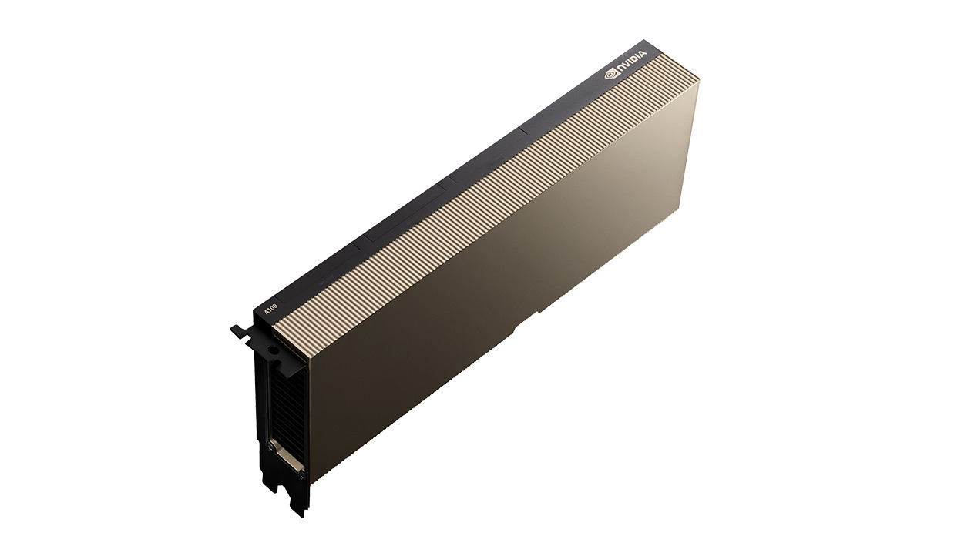
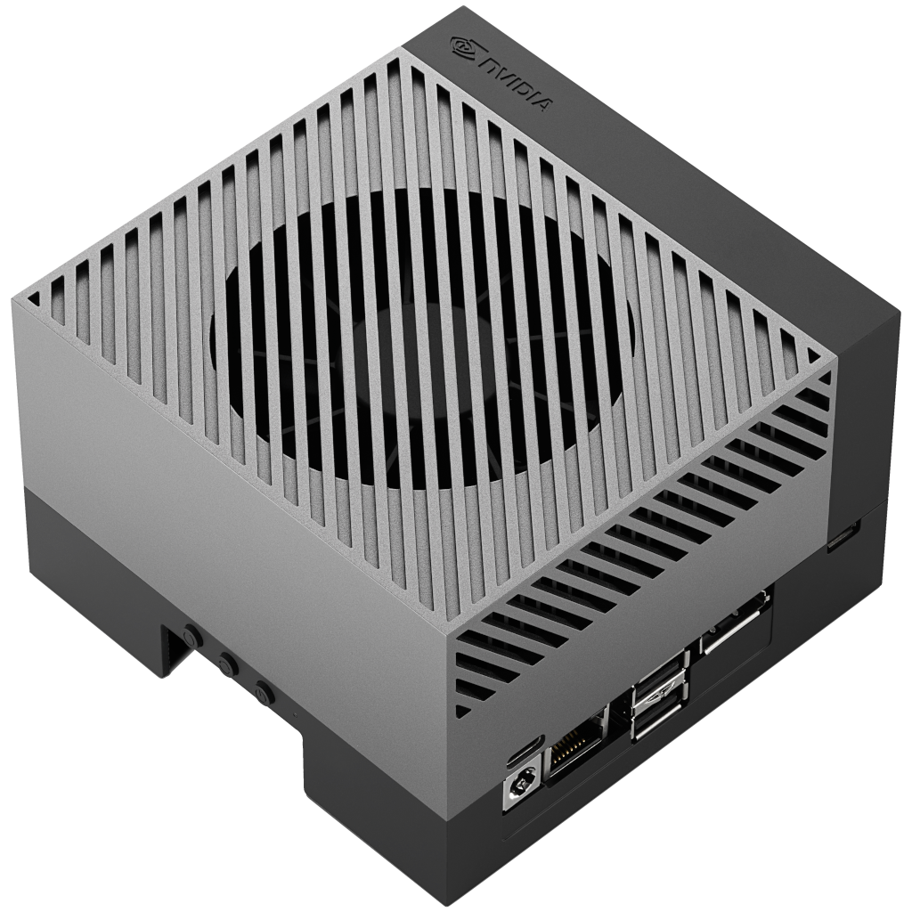

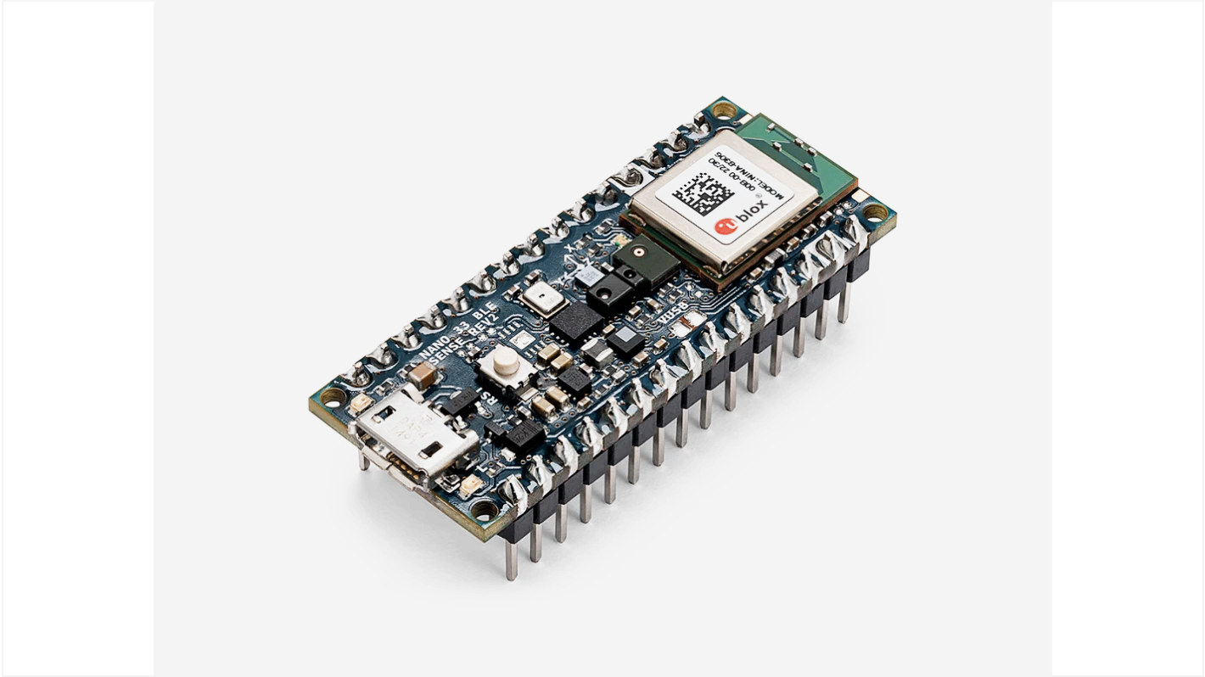
AI Hardware Spectrum: Key Examples（1/2）
Cloud ML
NVIDIA DGX 100
Edge ML
NVIDIA Jetson
AGX Orin
Mobile ML
iPhone
Tiny ML
Arduino Nano 33
BLE Sense
Notes:
Janapa Reddi, V. ML Systems Textbook. , from https://www.mlsysbook.ai/contents/core/ml_systems/ml_systems.html

Slide 5
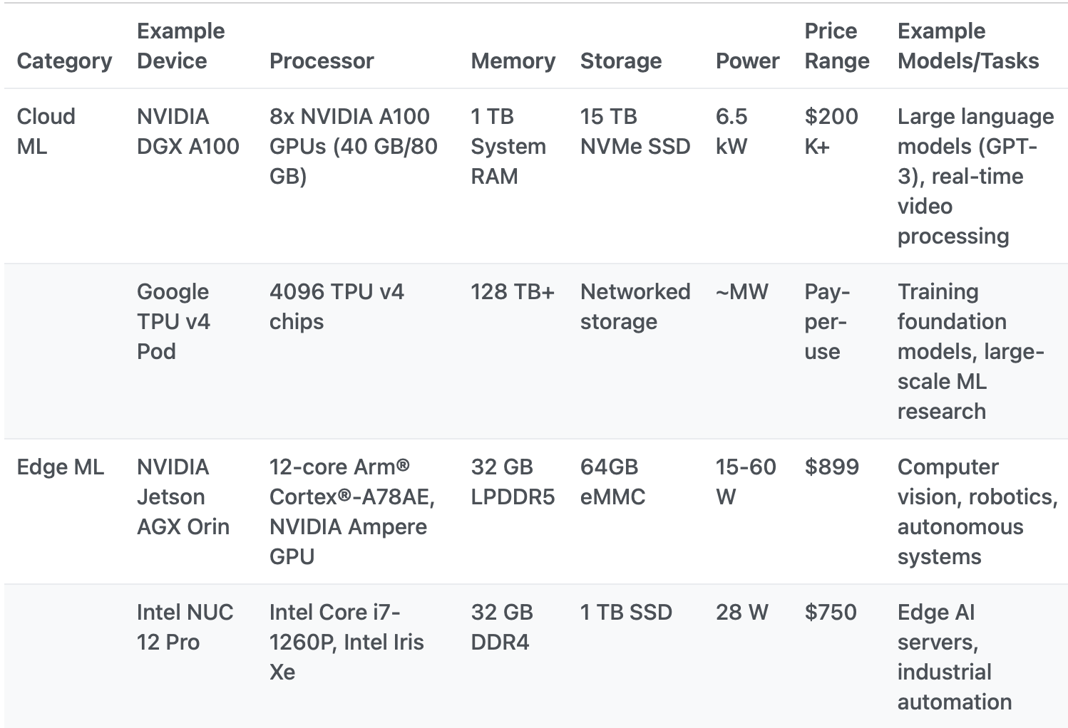
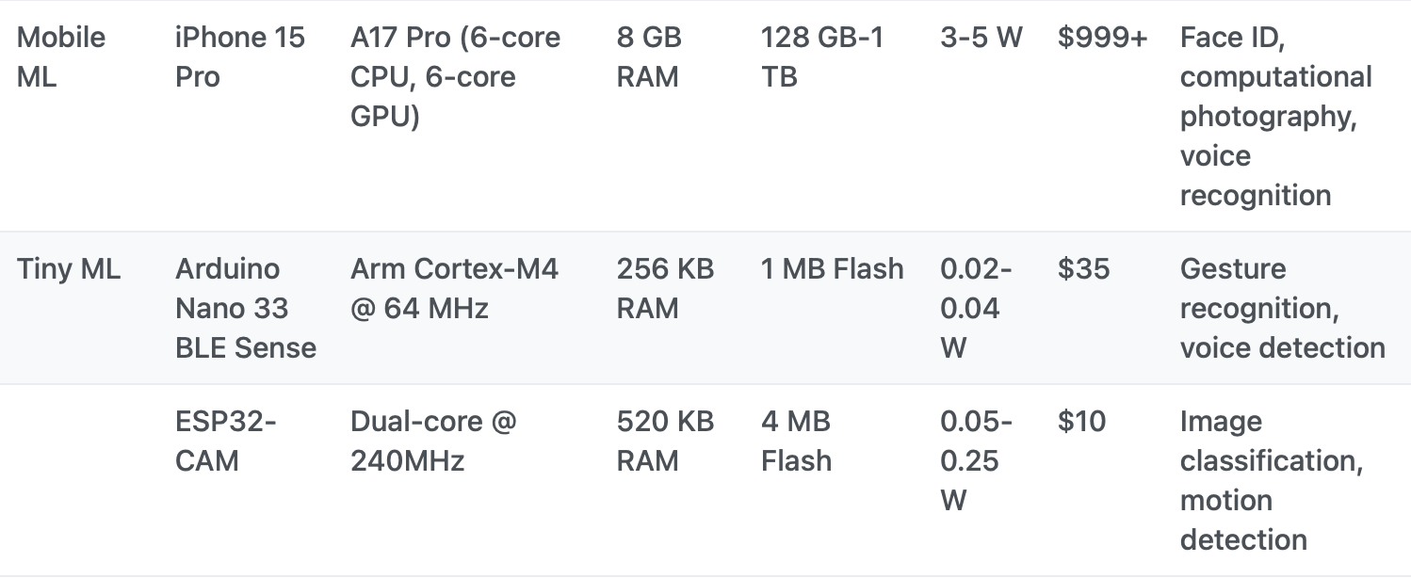
AI Hardware Spectrum: Key Examples（2/2）
https://www.mlsysbook.ai/contents/core/ml_systems/ml_systems.html
Notes:
Janapa Reddi, V. ML Systems Textbook. , from https://www.mlsysbook.ai/contents/core/ml_systems/ml_systems.html

Slide 6
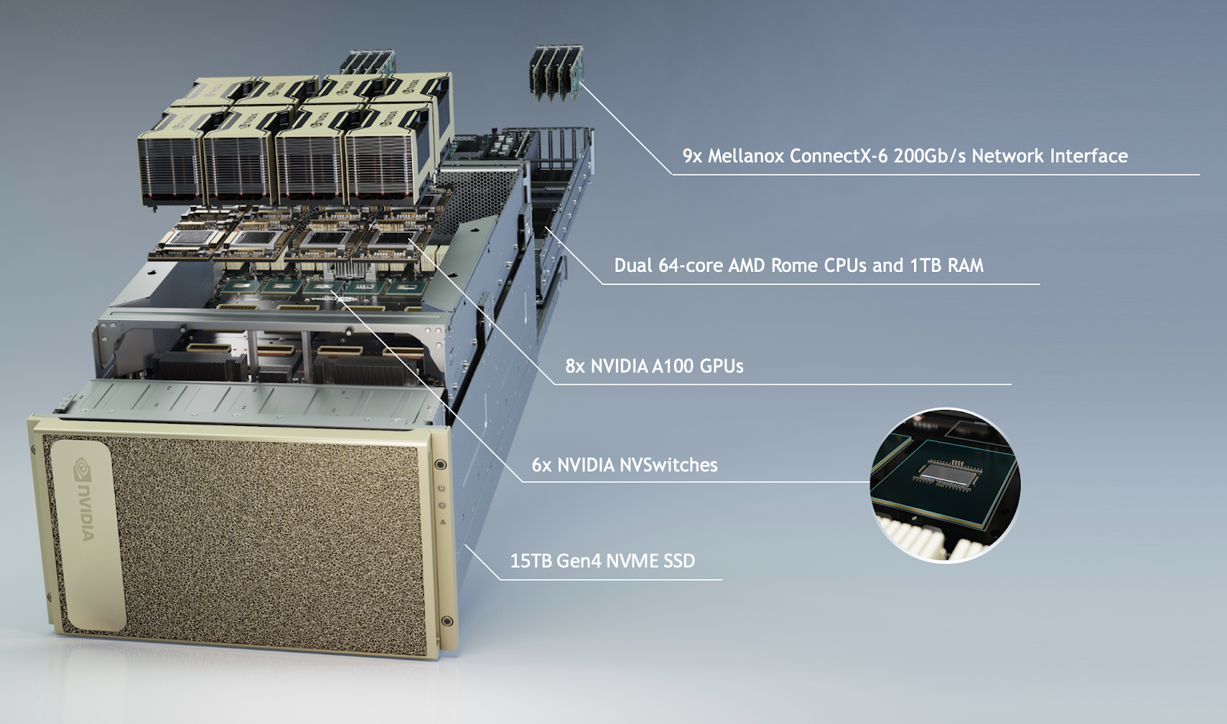
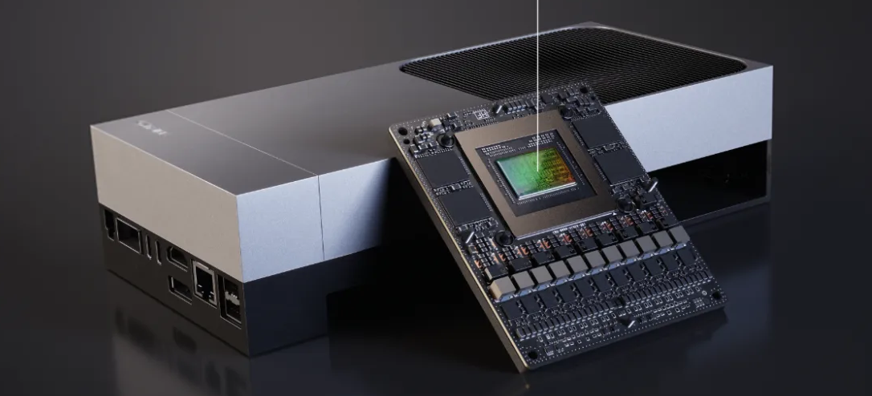
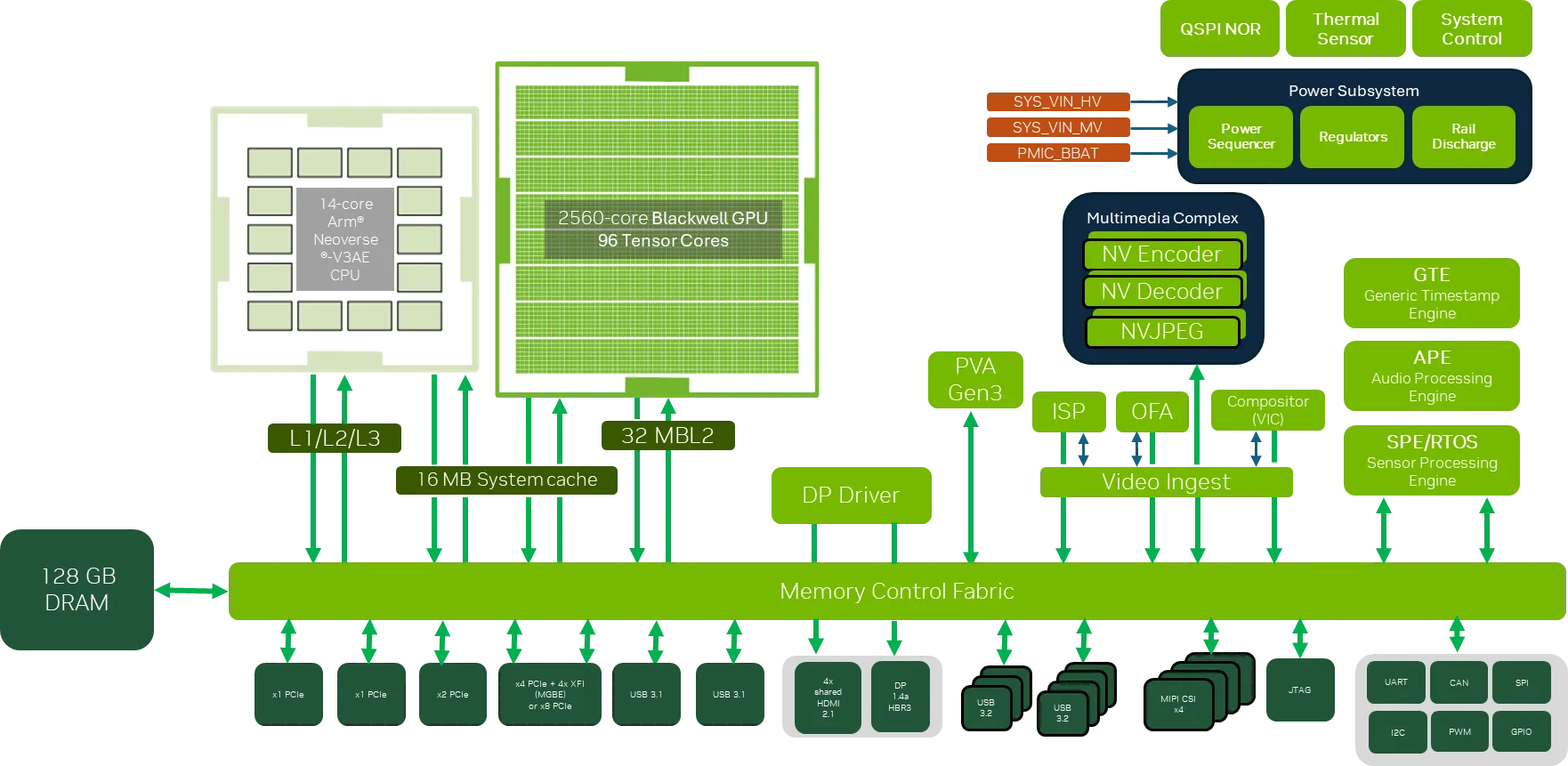
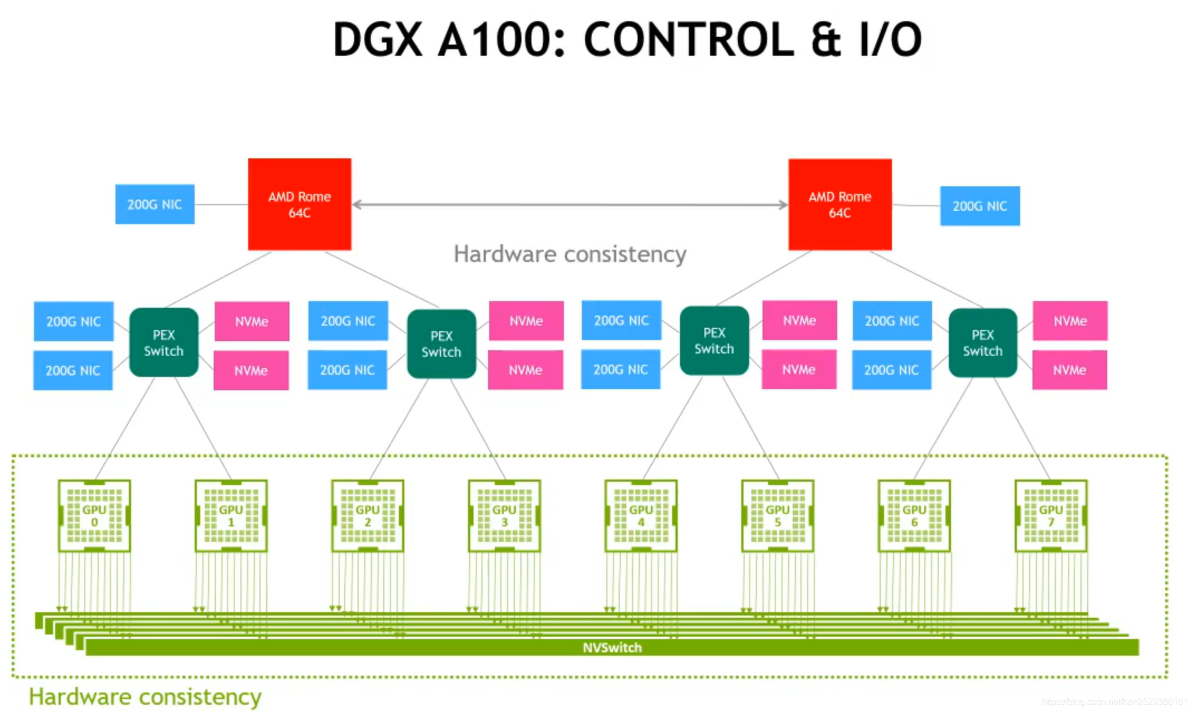
Two Forms of AI Chips (NVIDIA)
Discrete AI Chip: Standalone accelerators (e.g., DGX A100).
Integrated AI Chip: System-on-Chip/SoC (e.g., DRIVE Thor).
Notes:
https://applieddatasystems.com/hpc-solutions-2/gpu-servers/
https://developer.nvidia.com/blog/introducing-nvidia-jetson-thor-the-ultimate-platform-for-physical-ai/

Slide 7
Hetergeneous Integration of CPU and XPUs
Inter-chip (board-level) integration
protocols: PCIe, NVLink, etc.
Intra-chip integration
protocols: one-way or two-way coherency
CPU
“host”
XPU
“device”
CPU
“host”
XPU
“device”

Slide 8
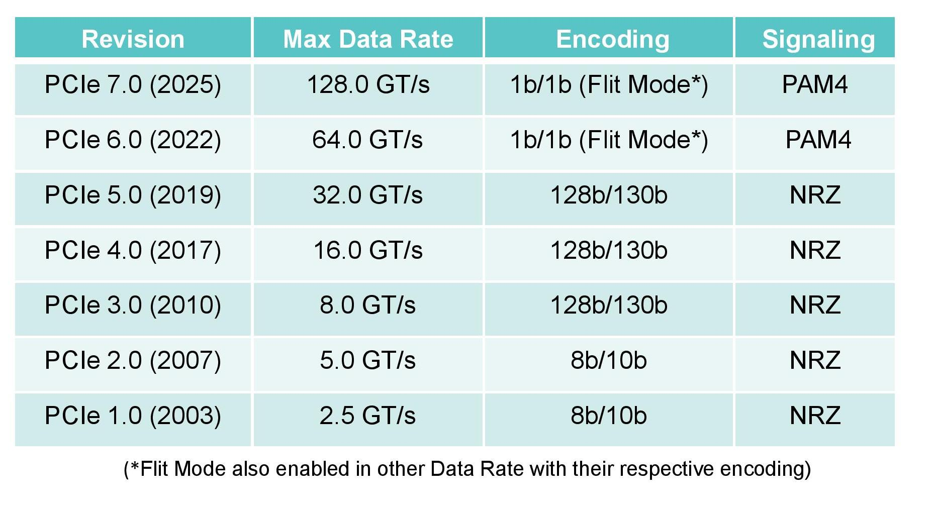
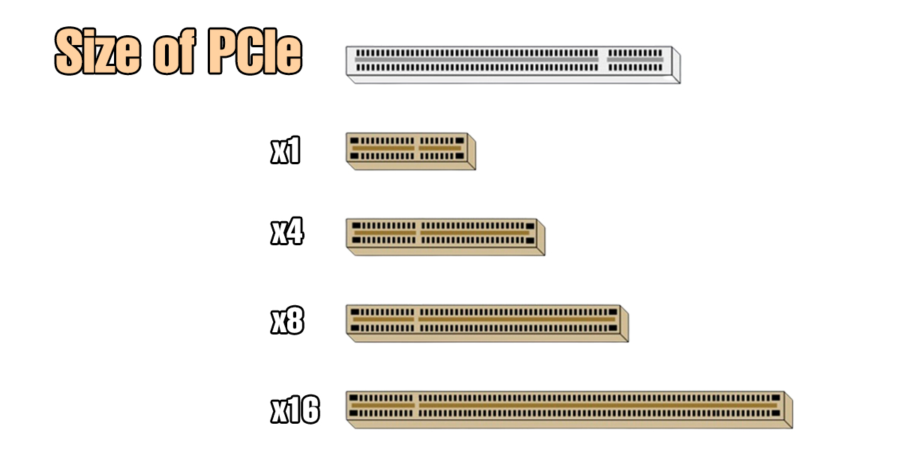
PCIe Basic Knowledge
Market Adoption (in Aug. 2025)
Mainstream: PCIe 4.0
Latest device: PCIe 5.0
Not yet in production: PCIe 6.0/7.0
PCIe Lanes
“x” = number of lane pairs (TX/RX)
e.g. PCIe 5.0, “x1” = 4GB/s, “x16” = 32GB/s
x4: most NVMe SSD, NIC
x16: most GPU, FPGA
Notes:
pic-1 src: https://www.fibermall.com/blog/pcie-development.htm?srsltid=AfmBOorQpZIXd2vThqYRYSiPnQA0t-vEEgy2qs2bqBwevFxZ18Css9BG
pic-2 src: https://global.icydock.com/resources/icy_tips_367.html

Slide 9
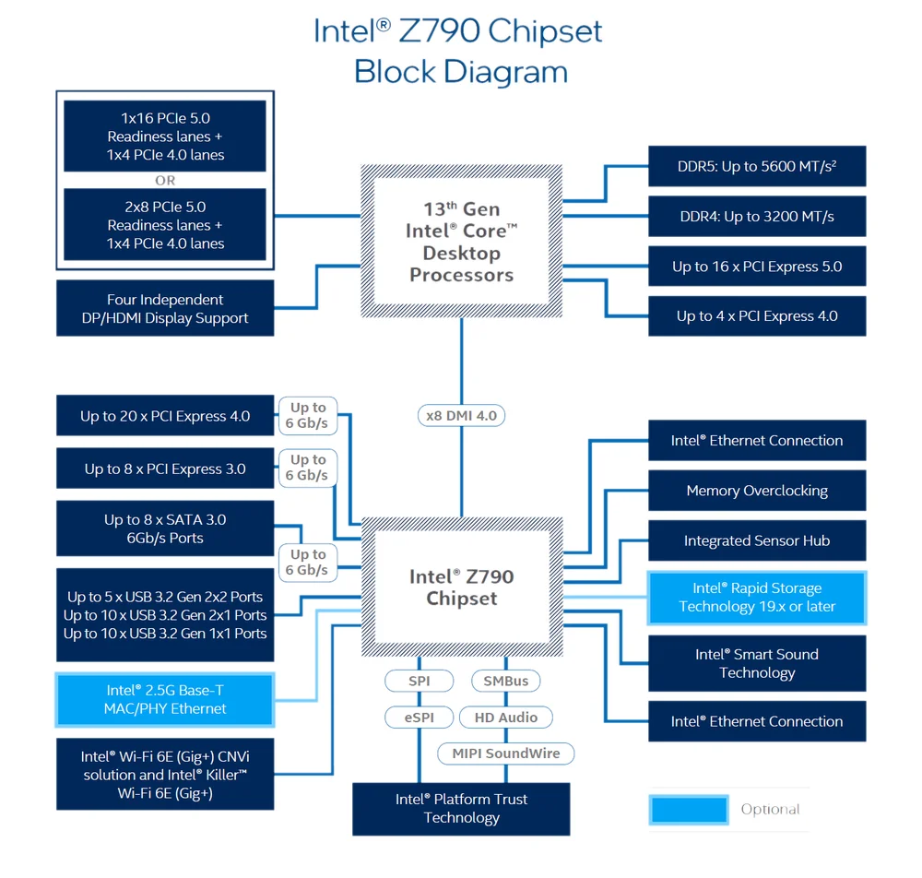
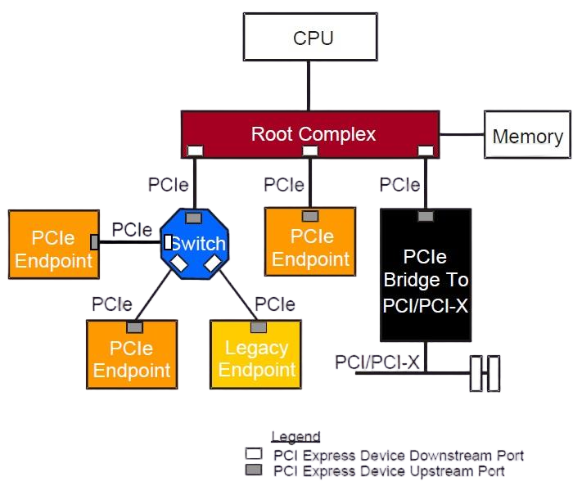
PCIe Architecture
Notes:
pic1: https://e2e.ti.com/support/processors-group/processors/f/processors-forum/465737/pcie-system-architecture
pic2: https://www.corsair.com/us/en/explorer/diy-builder/storage/what-is-pcie-and-how-does-it-work/?srsltid=AfmBOopOClHgxQNRCjM-qE1GfLF5emw_NG9baHGOoHVaTlt9bfUfwAtF

Slide 10
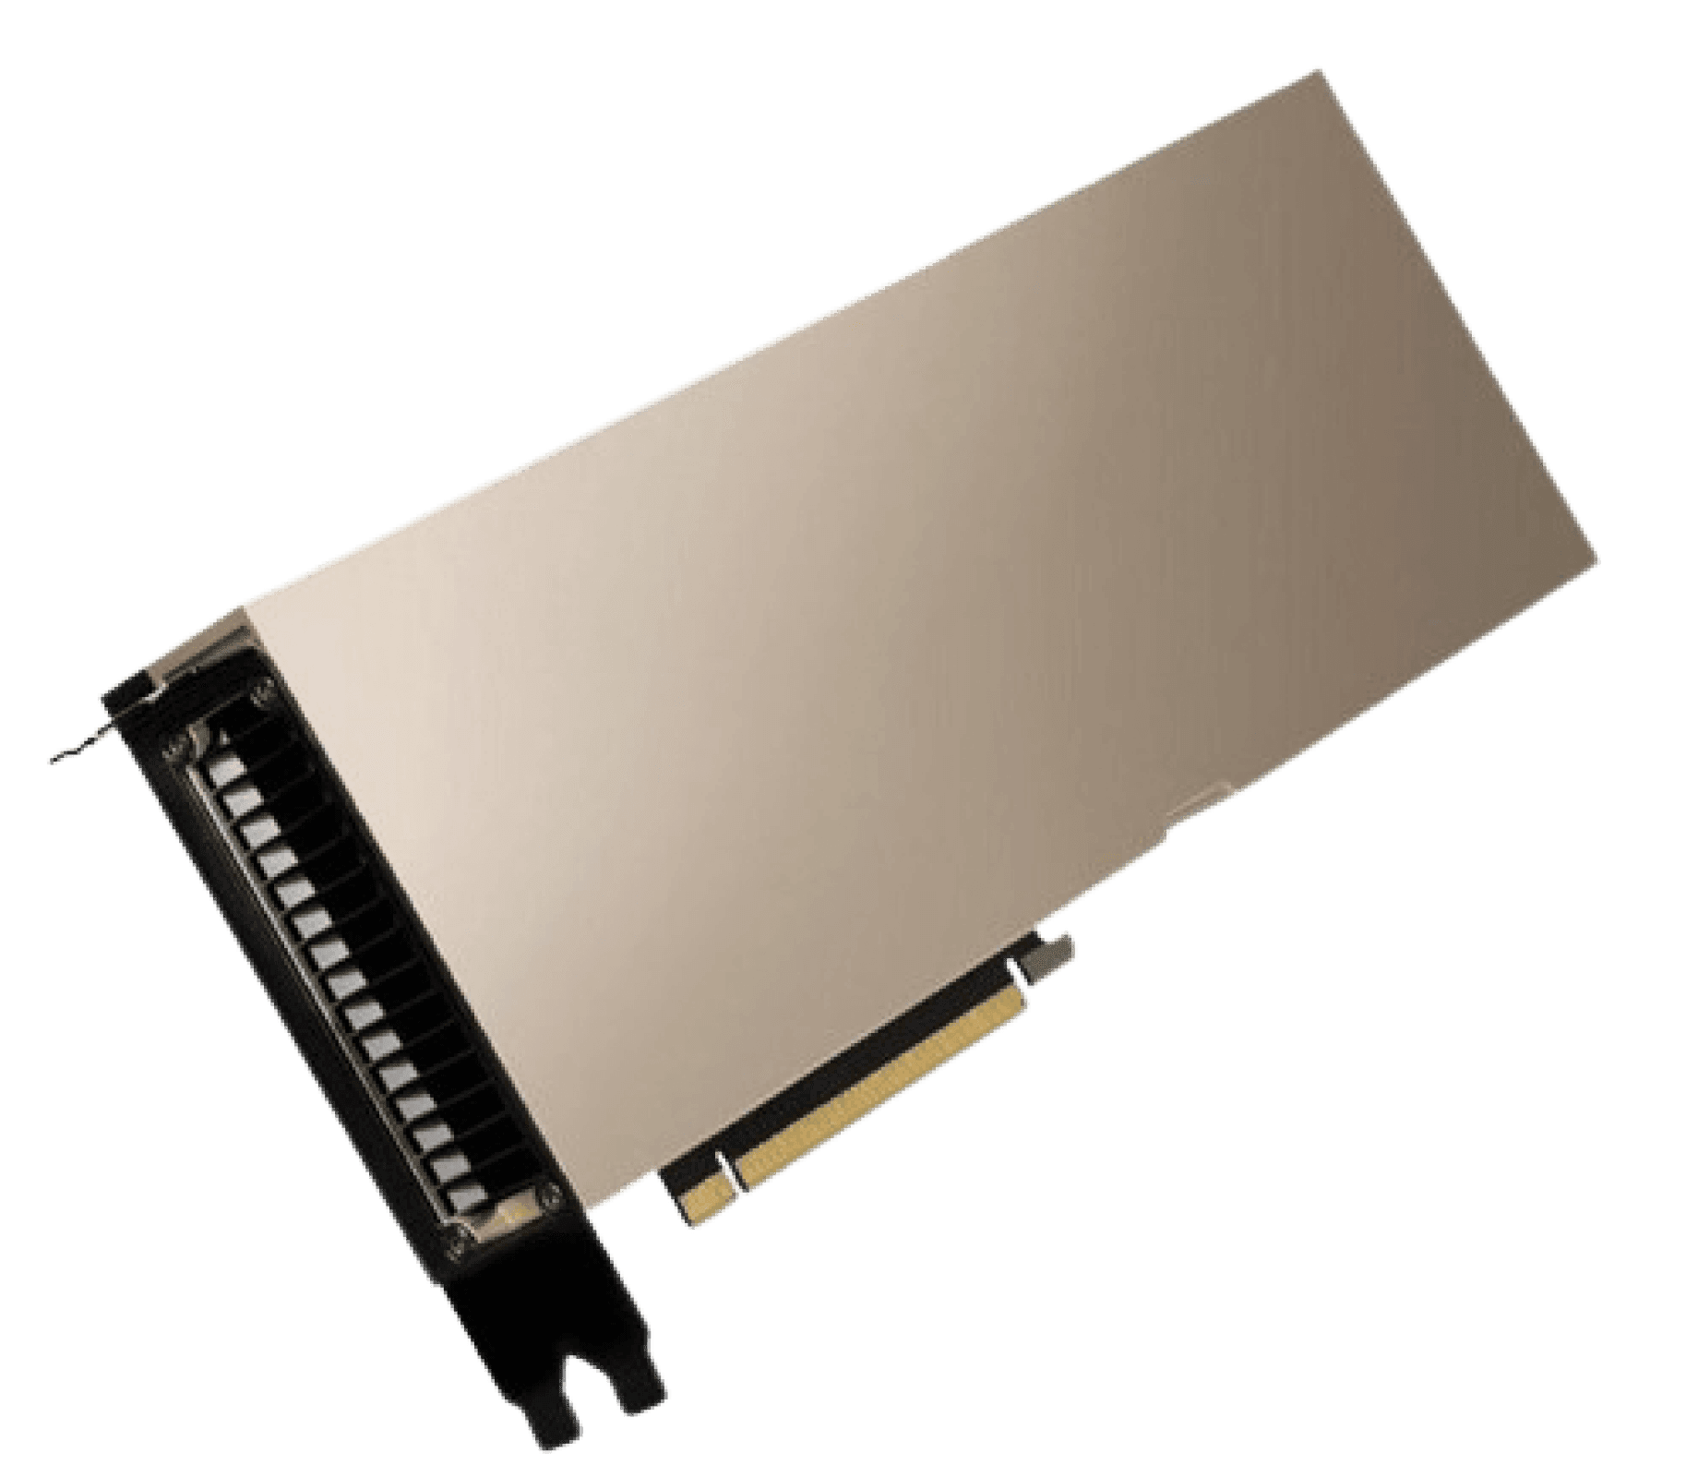
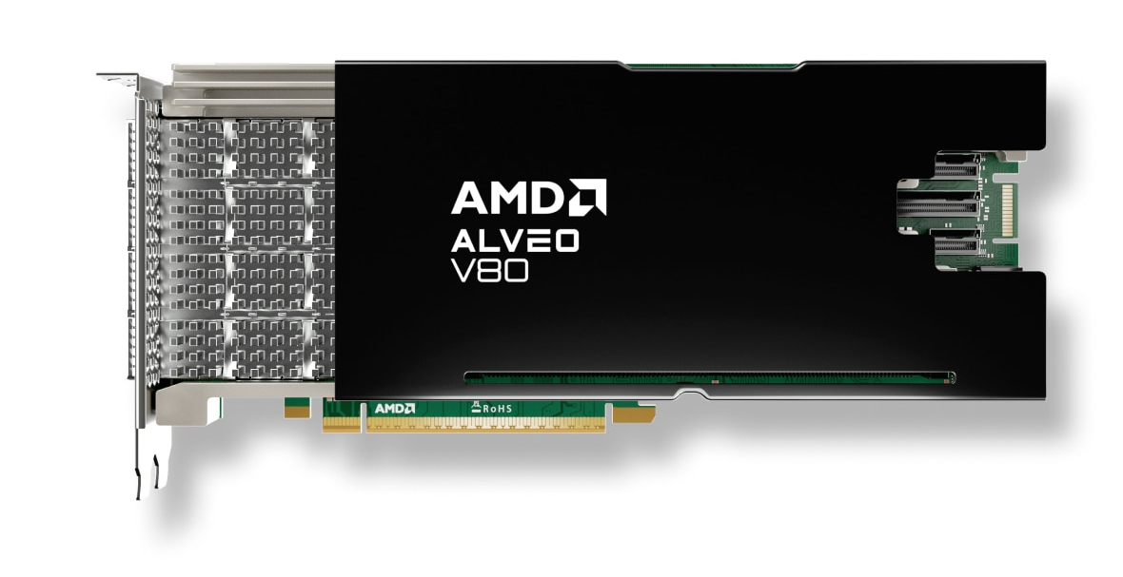
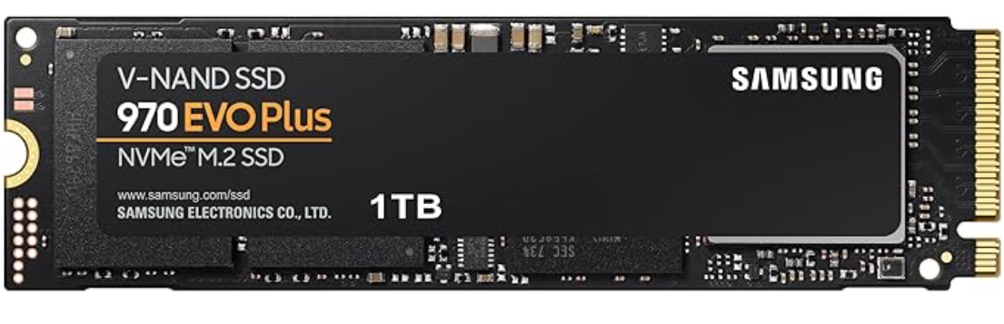
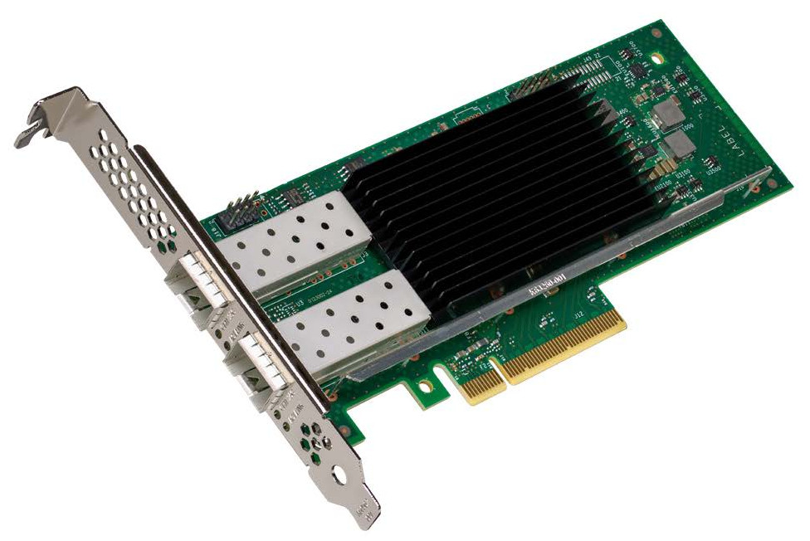
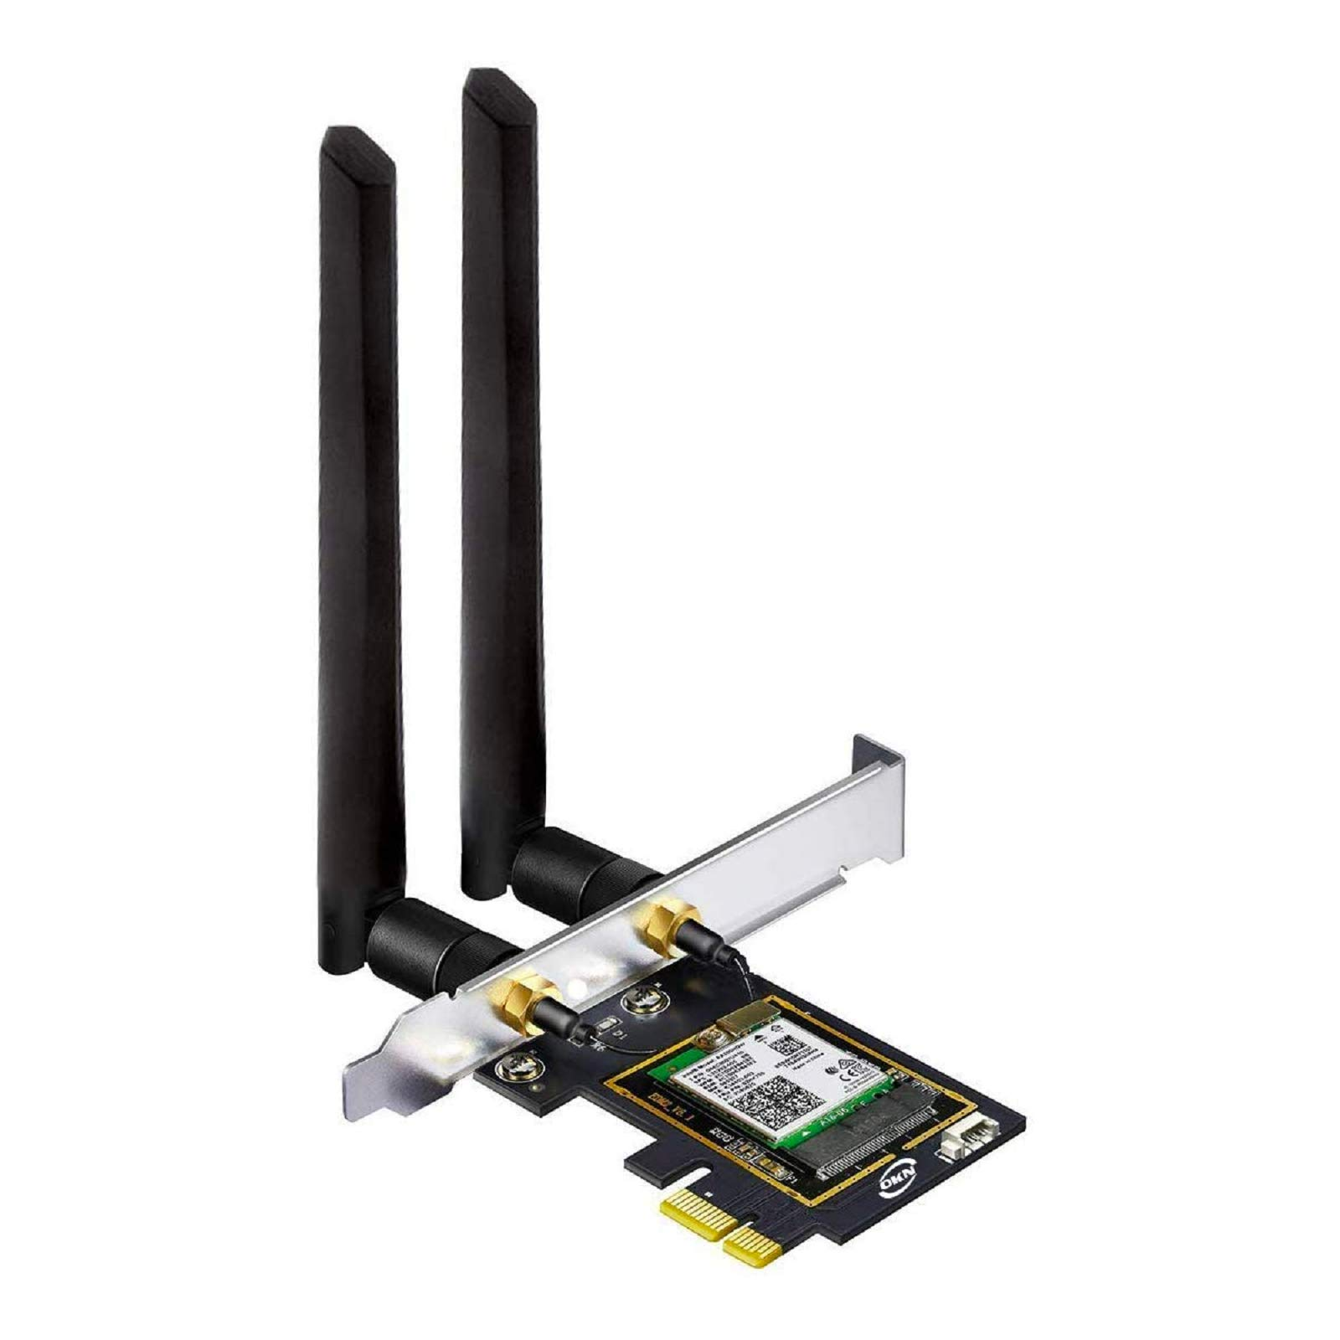
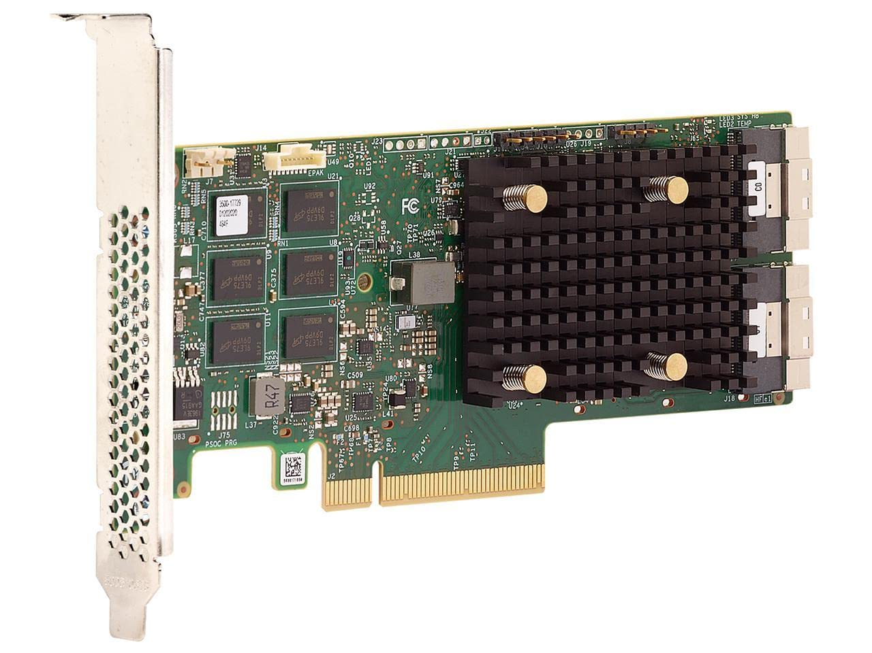
PCIe Devices
GPU
(Nvidia A100, PCIe 4.0 x16)
FPGA
(AMD V80, PCIe 4.0/5.0 x16)
NVMe SSD
(Sumsung 970, PCIe 4.0 x4)
Network Interface Card, NIC
(Intel E810 10/25 GbE, PCIe 4.0 x4)
WiFi 6E Card
(Intel AX210, PCIe 3.0 x1)
RAID Controller
(Broadcom 9560-16i, PCIe 4.0 x8)

Slide 11
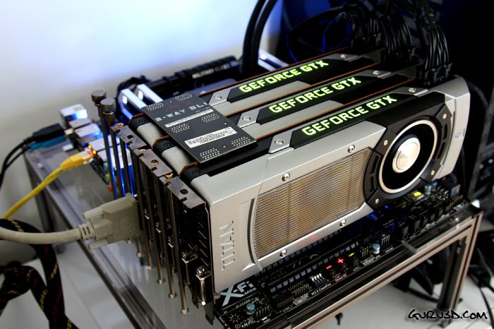
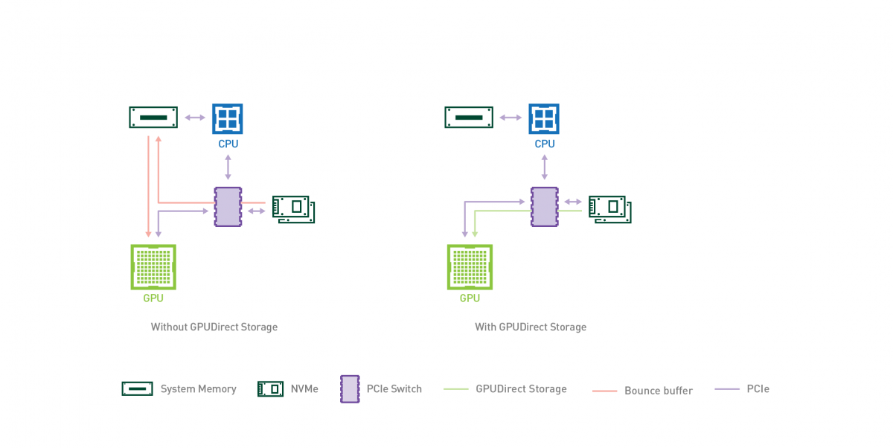
PCIe Role in AI: GPU-Host Connection
GPU connect to most Host with PCIe (currently 2025.08)
Host->GPU: Commands (CUDA kernels, OpenCL bin)
Training data, Model weights...
GPU->Host: GPU status (kernel completion, CUDA events)
Computation results (gradients, inference output)...
Traditional Data Transfer
1st Copy: NVMe SSD -> host Memory [with DMA]
2nd Copy: host Memory -> GPU Memory
Nvidia GPUDirect Storage (from 2020.06)
Only 1 Copy: NVMe SSD -> GPU Memory
GPUs to mainboard with PCIe
Notes:
https://www.zhihu.com/question/22233341/answer/1889610843068535566
gpu-cpu pic src: https://developer.nvidia.com/gpudirect

Slide 12
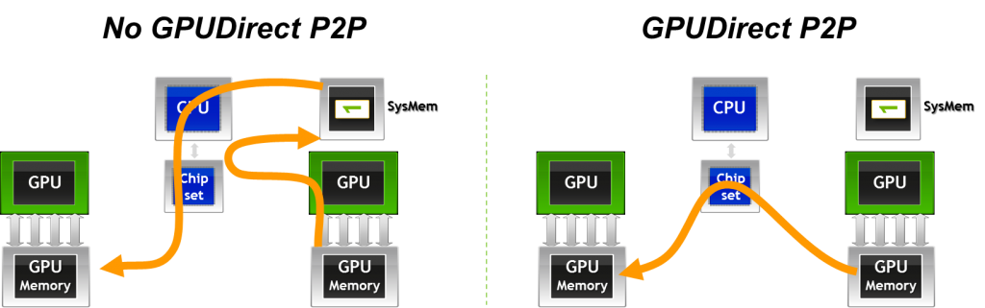
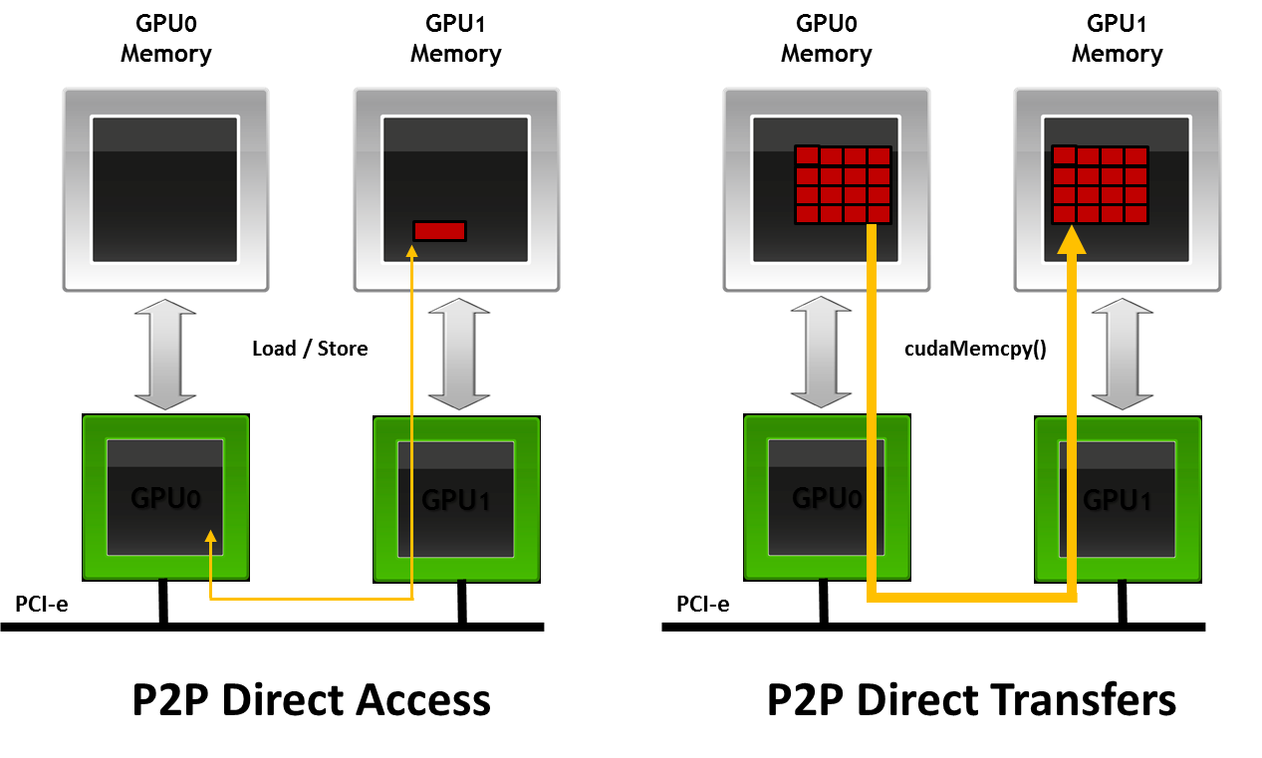
PCIe Role in AI: GPU-GPU Connection
GPU connect each other with PCIe (before 2016 NVlink published)
Data/Pipeline/Tensor/Expert Parallelism
Traditional Data Transfer
GPU₀ write to host shared memory
GPU₁ read from host shared memory
GPUDirect Peer-to-Peer
Direct access with Load/Store
Direct transfer with cudaMemCpy()
Notes:
gpudirect: https://developer.download.nvidia.com/devzone/devcenter/cuda/docs/GPUDirect_Technology_Overview.pdf
pic src:
https://developer.nvidia.com/blog/introduction-cuda-aware-mpi/
https://keeneland.gatech.edu/software/gpudirect.html
并行方式 产生大量P2P通信的阶段 典型通信量 对P2P带宽/延迟的敏感度
数据并行 梯度聚合（All-Reduce） 大，但可用Ring/Tree算法分摊到多链路 中等
模型并行/张量并行 每一步前向+反向，层内张量切片之间频繁交换中间结果 持续且密集的小包 极高
流水线并行 阶段边界的前向激活 & 反向梯度 阶段性脉冲式流量 高

Slide 13
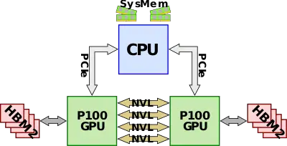
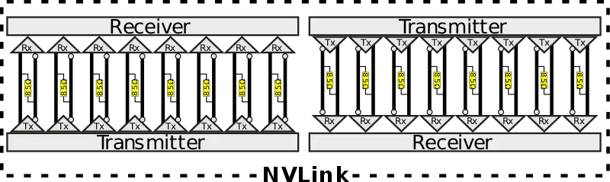
NVLink: GPU Interconnect
NVLink 1.0 first introduced with P100 GPU in 2016
4 NVLinks, each with 8 channels, 40 GB/s bidirectional bandwidth, 160 GB/s in total
Faster than PCIe 3.0 x 16 (32 GB/s)
Serial communication based on high-speed differential signaling
NVLink 1.0, 5 GB/s per channel
Notes:
pic: https://en.wikichip.org/wiki/nvidia/nvlink

Slide 14
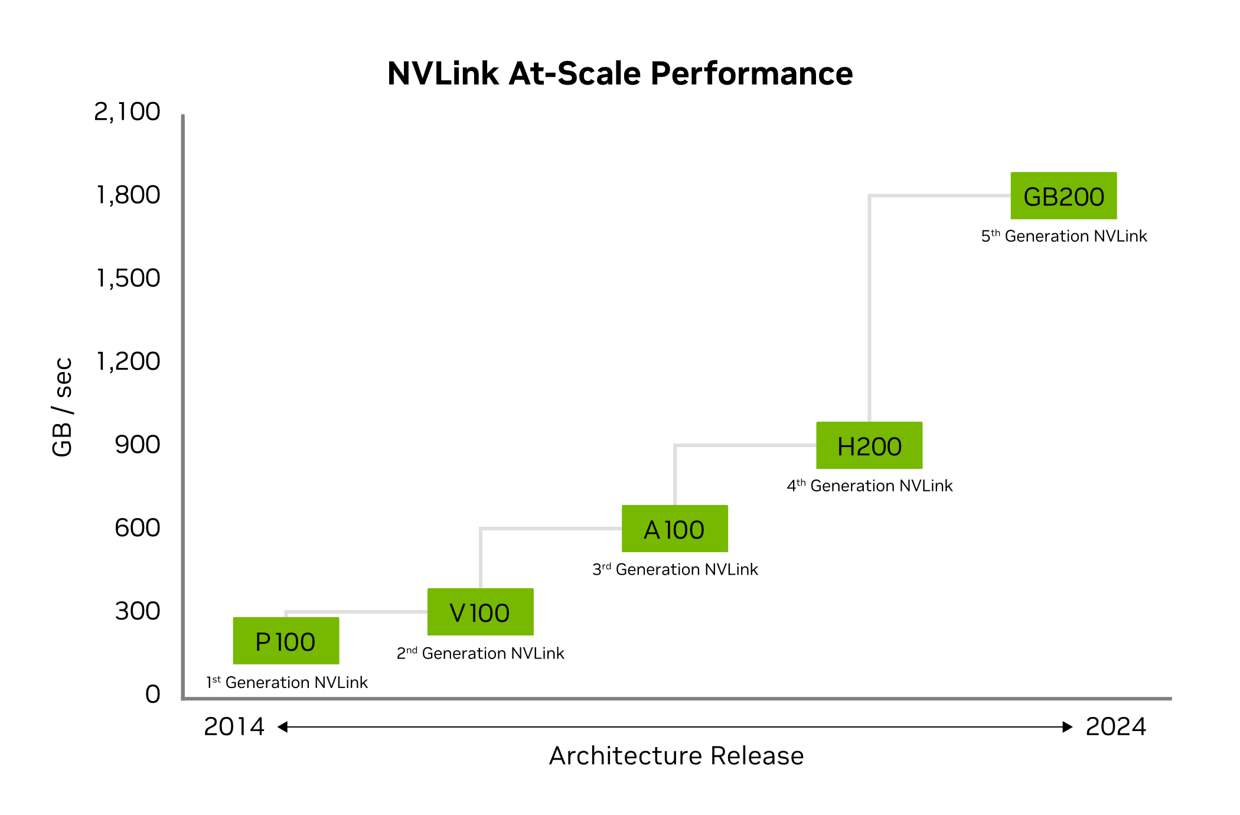
NVLink Generations
Updatest: NVLink 5.0 in 2024
 | NVLink 1 | NVLink 2 | NVLink 3 | NVLink 4 | NVLink 5
Year | 2016 | 2018 | 2020 | 2022 | 2024
Lanes per port | X8 | X8 | X4 | X2 | X2
Lane rate (Gbps) | 20 | 25 | 50 | 100 | 200
Modulation | NRZ | NRZ | NRZ | PAM4 | PAM4
Nyquist frequency (Gbaud) | 20 | 25 | 50 | 50 | 100
Bidirectional bandwidth per port (GB/s) | 40 | 50 | 50 | 50 | 100
Applicable GPU | P100 | V100 | A100 | H100 | B100
Ports per GPU | 4 | 6 | 12 | 18 | 18
Bandwidth per GPU (GB/s) | 160 | 300 | 600 | 900 | 900
Notes:
pic1: https://mp.weixin.qq.com/s?__biz=MzI1OTExNzkzNw==&mid=2650480852&idx=3&sn=9c1730bc2ba0262937e29a7096a0697d&chksm=f3811d2cccd9dfae64115574577a78a3875cdf8ef926a79ac1b03232dc910508cff4df37533b&scene=27&poc_token=HHU-pGij3SZqHxnt9yGj91eq4cMpN2yXbZjC5abD
pic2: https://www.nvidia.com/zh-tw/data-center/nvlink/

Slide 15
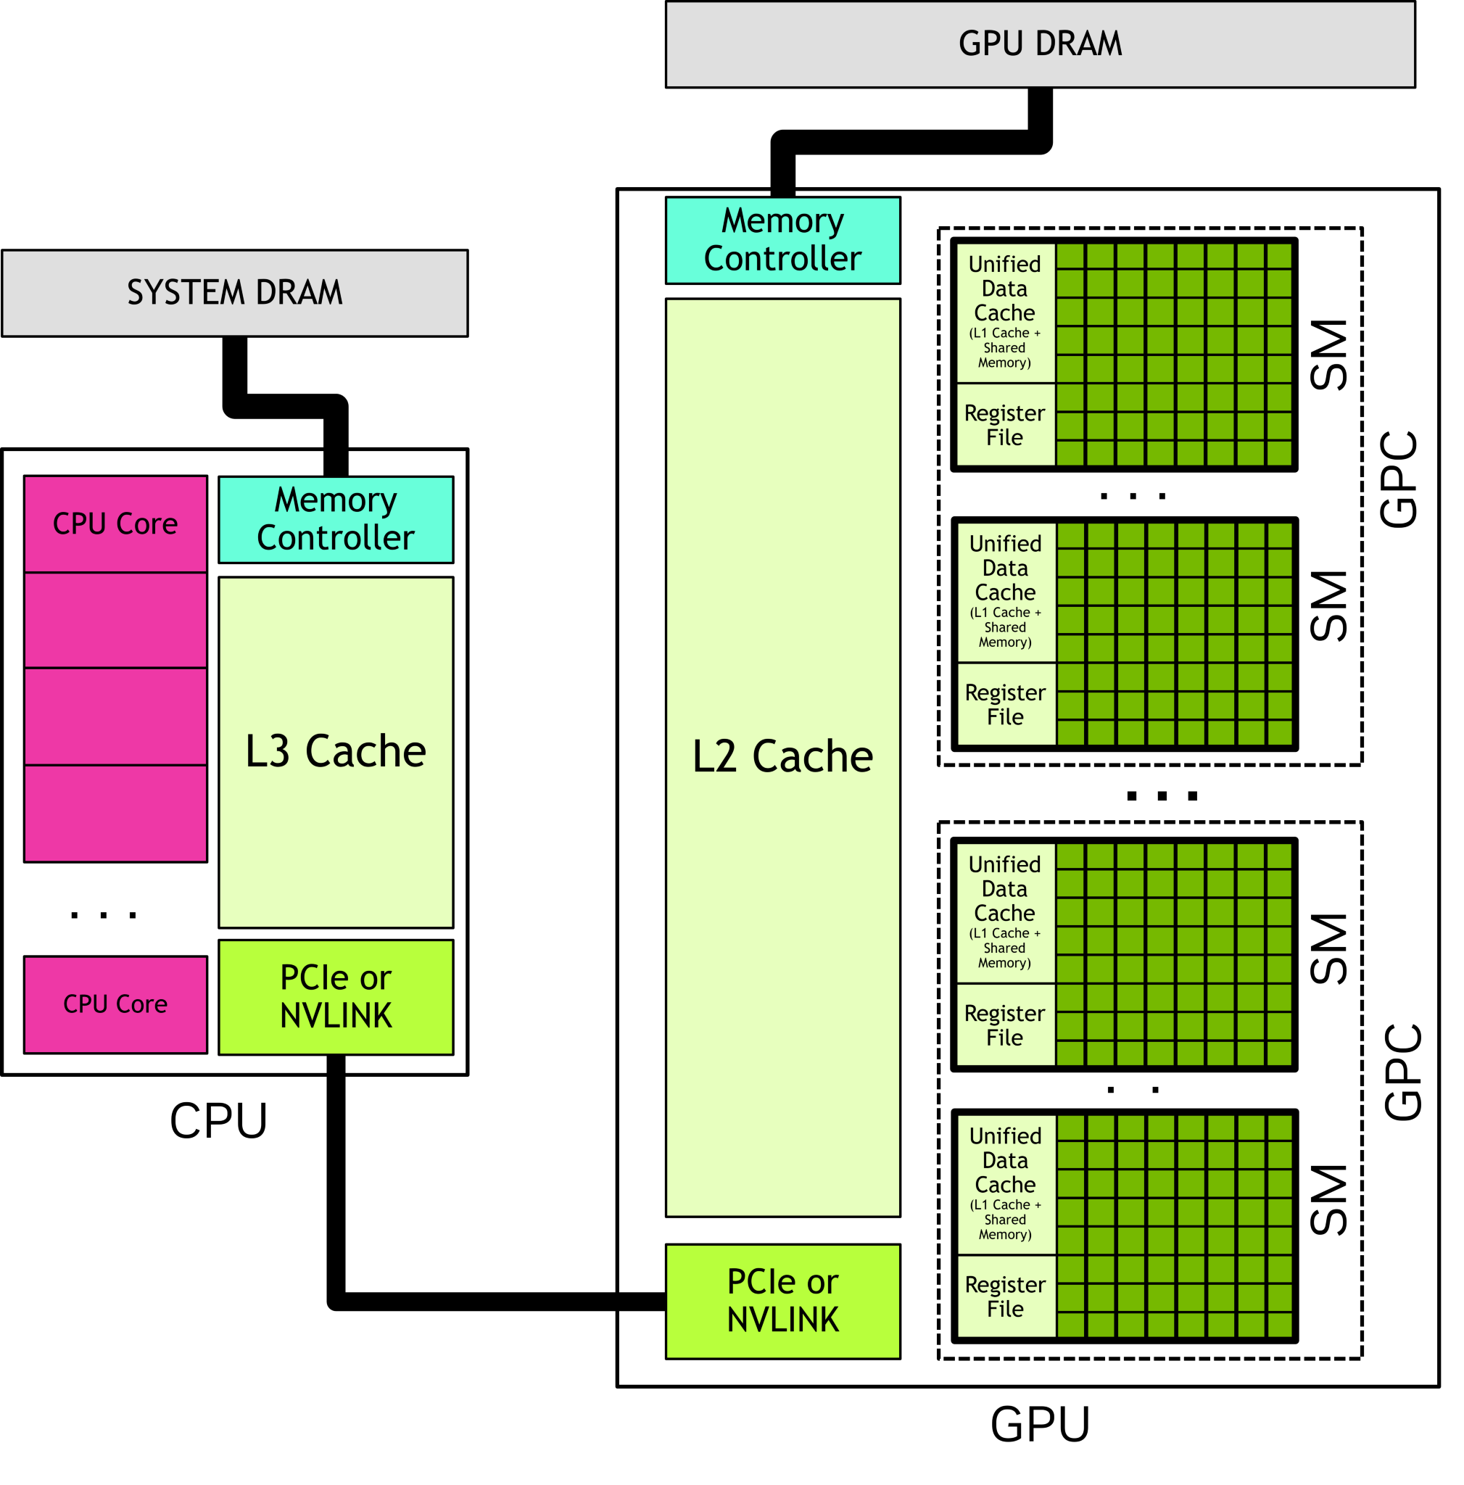
Heterogeneous Host-Device Interaction
without Unified Memory
with Unified Memory
① malloc
② cudaMalloc
③cudaMemcpy
...
⑥cudaMemcpy
④ cudaLaunchKernel
⑤cudaDeviceSynchronize
Notes:
单击此处添加文本

Slide 16
Outline
Host, Device, and Interconnect
Programming CUDA Cores
Programming Tensor Cores

Slide 17
Questions on Heterogeneous Programming
How to compile the “kernel” code?
How do CPU and GPU interact?
How to express parallelism?
How to express synchronization?
How to manage and access data?
How is kernel code executed on GPU?
Misc. topics
debugging tools
useful libraries

Slide 18
(incomplete list of) Concepts on Hetero-Programming
How to compile the “kernel” code?
How do CPU and GPU interact?
How to express parallelism?
How to express synchronization?
How to manage and access data?
How is kernel code executed on GPU?
a “”compiler” (later lectures)
host, device, kernels
threads, blocks, grid
__syncthreads()
xxMalloc(), xxxMemcpy(), global/shared/constant
warp scheduling

Slide 19
How do CPU and GPU interact?
A Tale of Host and Device
host ~ CPU; device ~ GPU
in OpenCL/ROCm, CPUs can also serve as devices
CPU-GPU interface
x86-NV5090 @ PCIe 5.0: 64 GB/s
Grace-Hopper NVLink C2C: 900 GB/s
Grace-Blackwell NVLink C2C: 1.8 TB/s
kernel ≈ a device function interface for the host
xxxMalloc(), xxxMemcpy()

Slide 20
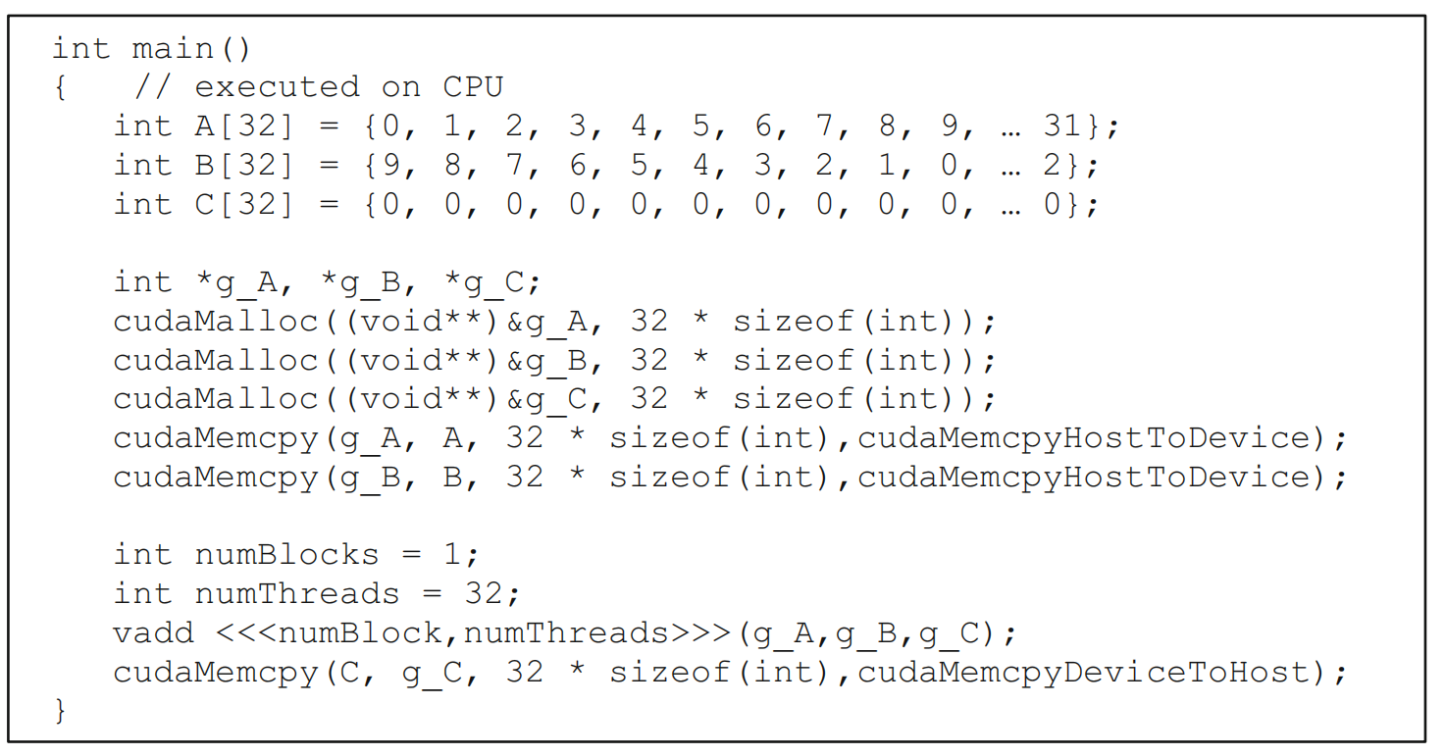
How do CPU and GPU interact? (host program)
Host program
Running as part of normal C/C++ application on CPU
Launch a grid of kernel thread blocks
Call returns when all threads have terminated

Slide 21
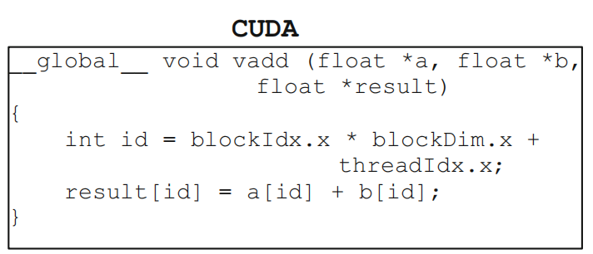
How do CPU and GPU interact? (kernel program)
Kernel definition
__global__ denotes a kernel function
Thread computes its thread id from its position in its block (threadIdx) and its block’s position in the grid (blockIdx)

Slide 22
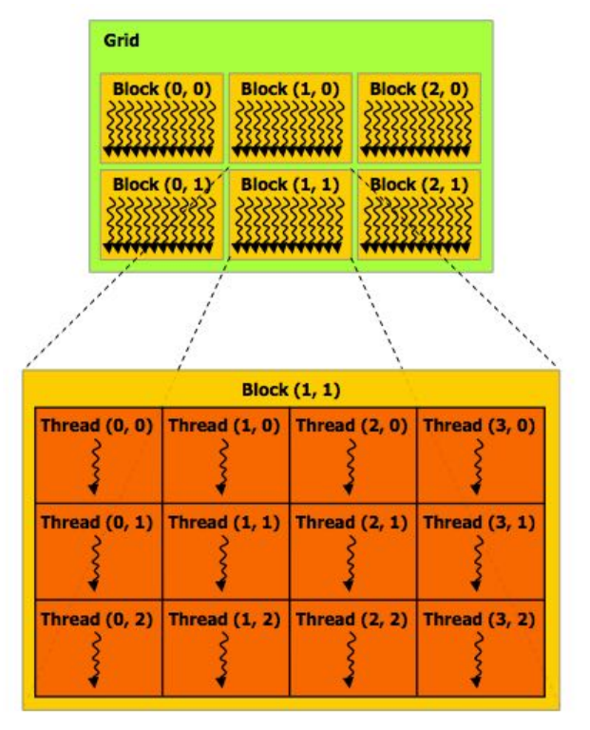
How to Express Parallelism?
Thread Hierachy
Thread
The smallest unit of execution
(not the smallest unit of scheduling)
Thread Block (Block)
A group of threads
Cooperate through shared memory and synchronization
Organized in up to 3-dims
Grid
A collection of thread blocks
Organized in up to 3-dims
Lauched by CPUs, executed on GPUs

Slide 23
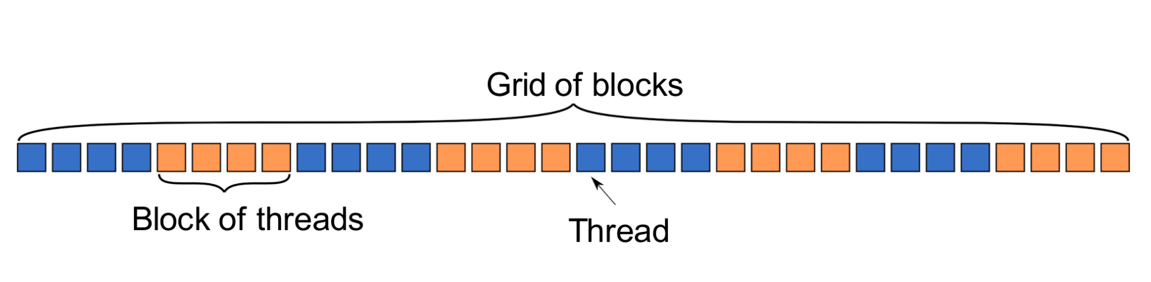
The Grid: Blocks of Threads in 1D
Threads in grid have access to:
Their respective block: blockIdx.x (for the “Thread” above: == 4)
Their respective thread ID in a block: threadIdx.x (for the “Thread” above: == 0)
Their block's dimension: blockDim.x (for the example above: == 4)
The number of blocks in the grid: gridDim.x (for the example above: == 8)
adapted from UW CSEP 590, Dr. Hari Sadasivan

Slide 24
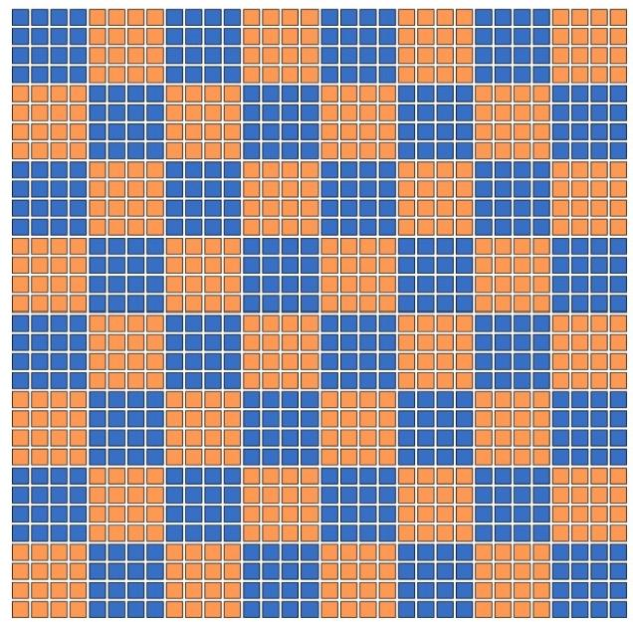
The Grid: Blocks of Threads in 2D
Each color is a block of threads
Each small square is a thread
The concept is the same in 1D and 2D
In 2D each block and thread now has
a two-dimensional index
Threads in grid have access to:
Their respective block IDs: blockIdx.x, blockIdx.y
Their respective thread IDs in a block: threadIdx.x, threadIdx.y
adapted from UW CSEP 590, Dr. Hari Sadasivan

Slide 25
How to Express Synchronizations?
__syncthreads()
xxxDeviceSynchronize()
events
(to be discussed in later lectures)

Slide 26
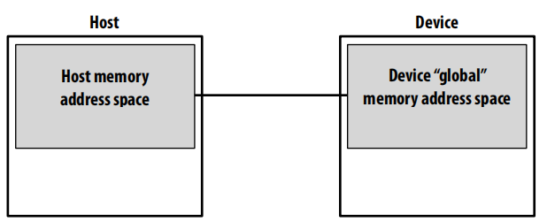
How to Manage and Access Data?
CUDA memory model
Distinct host and device address spaces (when not using unified memory)
Memory allocation in GPU through cudaMalloc()
Move data between address spaces through cudaMemcpy()

Slide 27
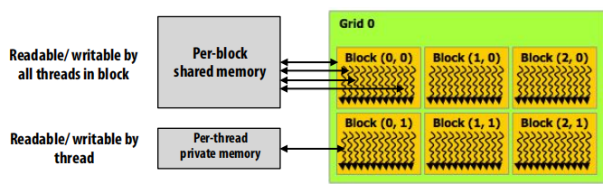
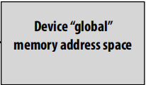
How to Manage and Access Data?
CUDA memory model
Three distinct types of address spaces visible to kernels
__global__: accessible by all threads
__device__: distinct from CPU memory
__shared__: shared by threads in a block

Slide 28
How is Kernel Code Executed on GPU?
SIMD execution can be combined with pipelining
ALUs all execute the same instruction
Pipelining is used to break instruction into phases
When first instruction completes (4 cycles here), the next instruction is ready to execute
SIMD Width
(16 in AMD)
(8 in NVIDIA)
Add
Mul
Add
Mul
Add
Mul
Add
Mul
Add
Mul
Add
Mul
Add
Mul
Add
Mul
…
Add
Mul
AMD: Wavefront
(64 work-items)
NVIDIA: Warp
(32 threads)
Add
Mul
Add
Mul
Add
Mul
Add
Mul
Add
Mul
Add
Mul
Add
Mul
Add
Mul
Add
Mul
Add
Mul
Add
Mul
Add
Mul
Add
Mul
Add
Mul
Add
Mul
Add
Mul
Add
Mul
Add
Mul
Add
Mul
Add
Mul
Add
Mul
Add
Mul
Add
Mul
Cycle
1 | 2 | 3 | 4 | 5 | 6 | 7 | 8 | 9
…

Slide 29
SIMD, SPMD, and SIMT (1/3)
SIMD is an architecture
A single sequential instruction stream of SIMD instructions
For example, a matrix-vector multiplcation using AVX-512:
static float *outx16; static float *avx512Multiply() { for (uint64_t i = 0; i < row; i++) { __m512 sumx16 = _mm512_set1_ps(0.0); for (uint64_t j = 0; j < col; j += 16) { __m512 a = _mm512_loadu_ps(&(t1[i*col + j])); __m512 b = _mm512_loadu_ps(&(t2[j])); sumx16 = _mm512_fmadd_ps(a, b, sumx16); } outx16[i] = _mm512_reduce_add_ps(sumx16); } return outx16; }
https://www.intel.com/content/www/us/en/developer/articles/technical/accelerating-compute-intensive-workloads-with-intel-avx-512-using-microsoft-visual-studio.html

Slide 30
SIMD, SPMD, and SIMT (2/3)
SPMD is a programming paradigm
“programmers normally write a single program that runs on all processors of an MIMD computer, relying on conditional statements when different processors should execute different sections of code.”
see Section 6.3 of Computer Organization and Design, Fifth Edition: The Hardware/Software interface by David A. Patterson, John L. Hennessy

Slide 31
SIMD, SPMD, and SIMT (3/3)
SIMT is both a programming model and an execution model
Multiple instruction streams of scalar instructions
Can treat each thread separately
i.e., can execute each thread independently (on any type of scalar pipeline)
MIMD processing
Can group threads into warps flexibly
i.e., can group threads that are supposed to truly execute the same instruction
dynamically obtain and maximize benefits of SIMD processing
For NVIDIA GPUs, warp size = 32; For AMD GPUs, wavefront size = 64
adapted from UW CSEP 590, Dr. Hari Sadasivan
Notes:
https://developer.nvidia.com/blog/using-cuda-warp-level-primitives/
NVIDIA GPUs execute warps of 32 parallel threads using SIMT, which enables each thread to access its own registers, to load and store from divergent addresses, and to follow divergent control flow paths.

Slide 32
SIMT: How to Express the Work of a Thread? (the Single Instruction Stream in SIMT)
A simple embarrassingly parallel loop:
for (int i= 0; i<N; i++)
h_a[i] *= 2.0;
Can be translated into a GPU kernel:
__global__ void myKernel(int N, double *d_a) {
int i = threadldx.x + blockldx.x * blockDim.x;
if (i<N) d_a[i] *= 2.0;
}
A device function that will be launched from the host program is called a kernel & is declared with the __global__ attribute
Kernels should be declared void
All pointers passed to kernels must point to memory on the device
All threads execute the kernel's body “simultaneously”
Each thread uses its unique thread and block IDs to compute a global ID
There could be more than N threads in the grid
adapted from UW CSEP 590, Dr. Hari Sadasivan

Slide 33
SIMT: How to Express the Thread Structure? (The Grid: Multi-threading in SIMT)
Kernels are launched from the host:
dim3 threads(256,1,1); // 3D dimensions of a block of threads
dim3 blocks((N+256-1)/256,1,1); // 3D dimensions the grid of blocks
myKernel<<<blocks,threads,0,0>>>(N,a);

Slide 34
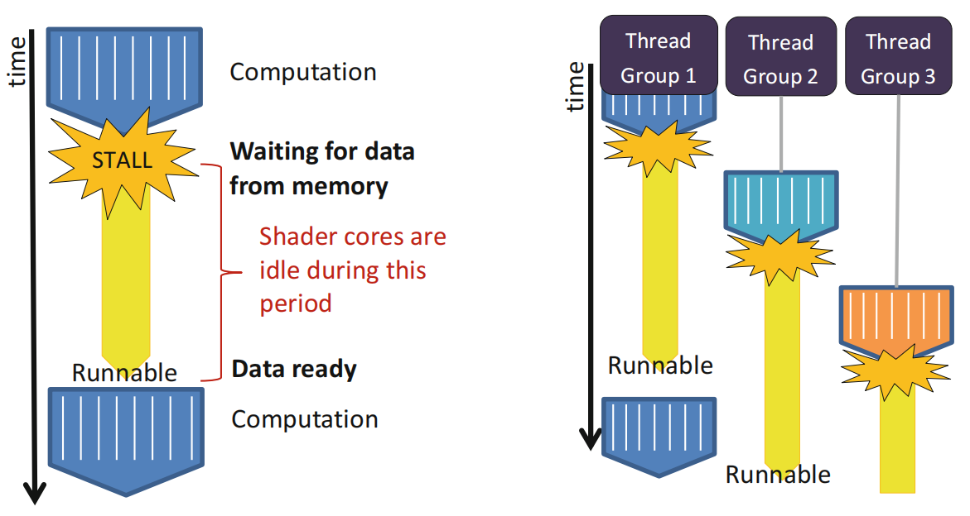
Optimizations
Resource-aware optimizations
resouces: SM, registers, shared memory, memory bandwidth
How? (a incomplete list)
choose an “optimal” block size, to maximize active warps
improve the utilization of memory bandwidth →
after partitioning, map the (task, data) to a suitable thread id
avoid control divergence
coalese global memory access
avoid shared memory bank conflicts
Performance analysis tools

Slide 35
Coalescing Memory Accesses: Example
Array X is a pointer to an array of integers (4-bytes each) located at address 0x00001232
A thread wants to access the data at X[0]
int tmp = X[0];
0
0x00001232
1
0x00001236
X
0x00001232
2
3
.
.
.
4
5
6
7
0x00001248
.
.
.
.
Notes:
This is the start of an example explaining how GPU’s wide memory buses work.

Slide 36
Coalescing Memory Accesses: Bus Addressing (1/2)
Assume that the GDDR memory bus is 32-bytes (256-bits) wide
The byte-addressable bus must make accesses that are aligned to the bus width, so the bottom 5 bits are masked off
Any access in the range 0x00001220 to 0x0000123F will produce the address 0x00001220
Desired address: | 0x00001232
Bus mask: | 0xFFFFFFE0
Bus access: | 0x00001220

Slide 37
Coalescing Memory Accesses: Bus Addressing (2/2)
All data in the range 0x00001220 to 0x0000123F is returned on the bus
In this case, 4 bytes are useful and 28 bytes are wasted
Memory Controller
Send an address
Receive data
Desired element
0x00001232
?
?
?
0
1
2
3
4
0x00001220
Notes:
The desired element is at 0x00001232 as shown 2 slides back.

Slide 38
Coalescing Memory Accesses (1/2)
To fully utilize the bus, GPUs combine the accesses of multiple threads into fewer requests when possible
Consider the following kernel code:
Assuming that array X is the same array from the example, the first 16 threads will access addresses 0x00001232 through 0x00001272
If each request was sent out individually, there would be 16 accesses total, with 64 useful bytes of data and 448 wasted bytes
Notice that each access in the same 32-byte range would return exactly the same data
int tmp = X[threadIdx.x + blockDim.x * blockIdx.x];

Slide 39
Coalescing Memory Accesses (2/2)
When GPU threads access data in the same 32-byte range, multiple accesses are combined so that each range is only accessed once
Combining accesses is called coalescing
For this example, only 3 accesses are required
If the start of the array was 256-bit aligned, only two accesses would be required
?
?
?
0
1
2
3
4
0x00001220
5
6
7
8
9
10
11
12
0x00001240
13
14
15
?
?
?
?
?
0x00001260

Slide 40
Outline
Host, Device, and Interconnect
Programming CUDA Cores
Programming Tensor Cores

Slide 41
Tensor Core Evolution
Trending:
Larger MMA size and arithmetic intensity
Support for lower precisions and async, vectorized memory copy
Arch | Dtype | TC per SM | TC m,n,k | Sparsity | Mem. Access | Instructions
Volta(SM70) | FP16 | 8 | 4 x 4 x 4 | No | N/A | mma
Turing(SM75) | FP16,INT8,INT4,Binary | 8 | 4 x 4 x 4 | No | ldmatrix | mma,ldmatrix
Ampere(SM80) | FP16,BF16,TF32,FP64,INT8,INT4,Binary | 4 | 8 x 4 x 8 | Yes | async Copy | mma,ldmatrix, mma.sp
Hopper(SM90) | FP16,BF16,TF32,FP64,INT8,Binary | 4 | 8 x 4 x 16 | Yes | TMA | mma,ldmatrix, mma.sp, wgmma

Slide 42
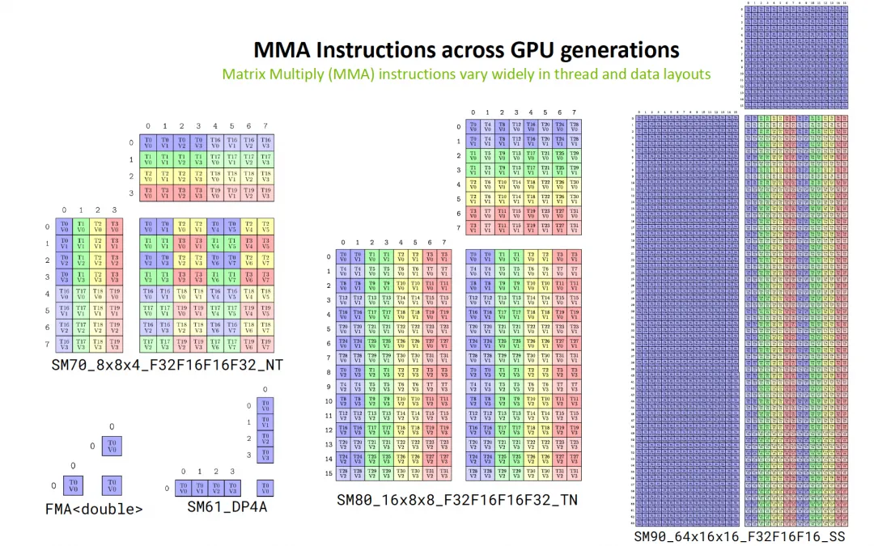
Tensor Core Evolution

Slide 43
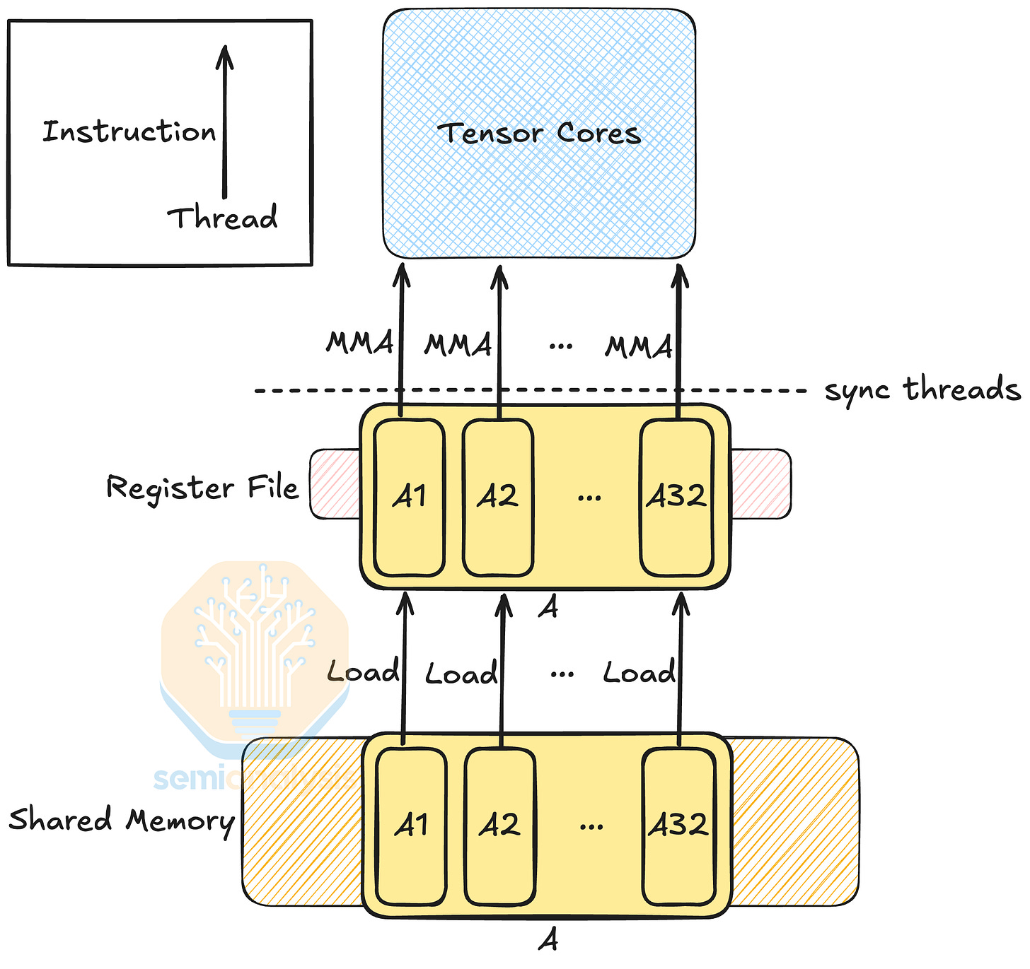
MMA Overview
Given a matrix, the multiply and accumulate (MMA) instruction computes D = A * B + C:
A is an M by K matrix
B is a K by N matrix
C and D are M by N matrices
We denote the matrix shapes as mMnNkK or MxNxK.
SMEM <-> RF <-> Tensor Core

Slide 44

The Solution: FlagOS, a Unified AI Software Stack

Slide 45








https://space.bilibili.com/3546791834290849
https://github.com/flagos-ai
https://www.zhihu.com/people/95-22-20-18/posts
https://flagos.io/Home

Slide 46

Thanks for your time！

